Slide 1
Conservation of Energy
Gizmos Activities

Slide 2

Class Code: NGYZVRAFGF

Slide 3
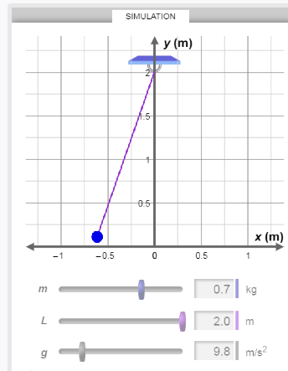
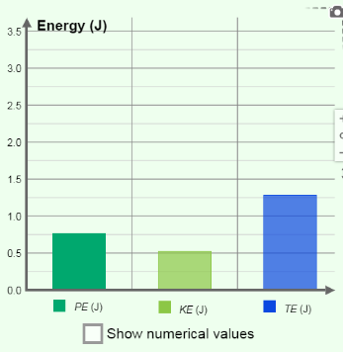
Energy of a Pendulum
Where is the Gravitational PE maximum?
Location(s) and Value(s)
Where is the Gravitational PE minimum?
Location(s) and Value(s)
Where is the Kinetic Energy maximum?
Location(s) and Value(s)
Where is the Kinetic Energy minimum?
Location(s) and Value(s)
Pick a Mid-Way swing location
How does the sum of E_{G} + E_{K} compare to the Total Energy?
Pick another Mid-Way swing location
How does the sum of EG + EK compare to the Total Energy?

Slide 4
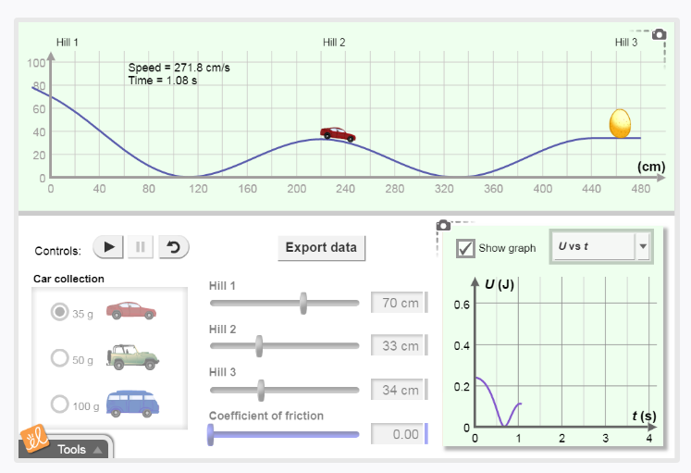
Roller Coaster Physics
Create 3 hills and don’t break the egg.
How does Kinetic Energy change with time (K vs t)?
Where on the track is it maximum?
Where on the track is it minimum?
Where on the track is it half-way?
How does Gravitational PE change with time (U vs t)?
Where on the track is it maximum?
Where on the track is it minimum?
Where on the track is it half-way?
How does Total Energy change with time (E vs t)?
What does this say about E_{G} + E_{K} ?

